Slide 1

Problem Statement
Domain :
1) ML
Problem Statement Title: Text Summarization
UN Sustainable Development Goal : Quality Education

Slide 2
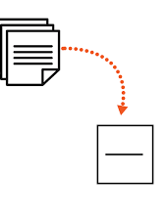
Idea/Approach Details
Describe your idea/Solution/Prototype here:
Text summarization is a very useful and important part of Natural Language Processing (NLP).
Suppose we have too many lines of text data in any form, such as from articles or magazines or on social media. We have time scarcity so we want only a nutshell report of that text.
We can summarize our text in a few lines by removing unimportant text and converting the same text into smaller semantic text form.

Slide 3
Idea/Approach Details
Describe your Use Cases here
In this approach we build algorithms or programs which will reduce the text size and create a summary of our text data. This is called automatic text summarization in machine learning.
There are two approaches to text summarization:
Extractive approaches:
Using an extractive approach we summarize our text on the basis of simple and traditional algorithms. For example, when we want to summarize our text on the basis of the frequency method, we store all the important words and frequency of all those words in the dictionary. On the basis of high frequency words, we store the sentences containing that word in our final summary. This means the words which are in our summary confirm that they are part of the given text.
Abstractive approaches:
An abstractive approach is more advanced. On the basis of time requirements we exchange some sentences for smaller sentences with the same semantic approaches of our text data.

Slide 4
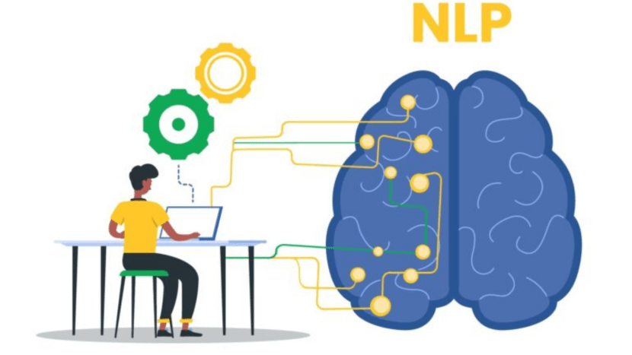
Implementation Strategy
Describe your Technology stack here:
Python(NLP):
Natural Language Processing (NLP) is a ubiquitous application of modern machine learning techniques.It deals with how computers can be trained and programmed to understand multiple languages both in written and oral form.
It is one of the broadest fields in research because there is a huge amount of data out there and from that data, a big amount of data is text data. So when there is so much data available so we need some technique threw which we can process the data and retrieve some useful information from it.

Slide 5
Business Potential
Describe How Revenue will be generated , Market Size , Competitors , Initial Investment etc..
There are multiple ways in which Text Summarization can be used in business:
Media Monitoring
Financial Research
Chatbots and Autoresponder
Content Creation
Remote Working and Video Conferencing

